Slide 1
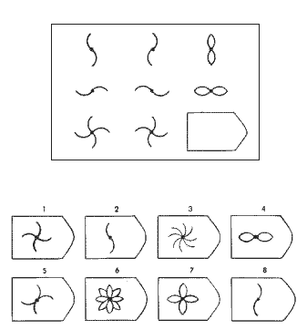
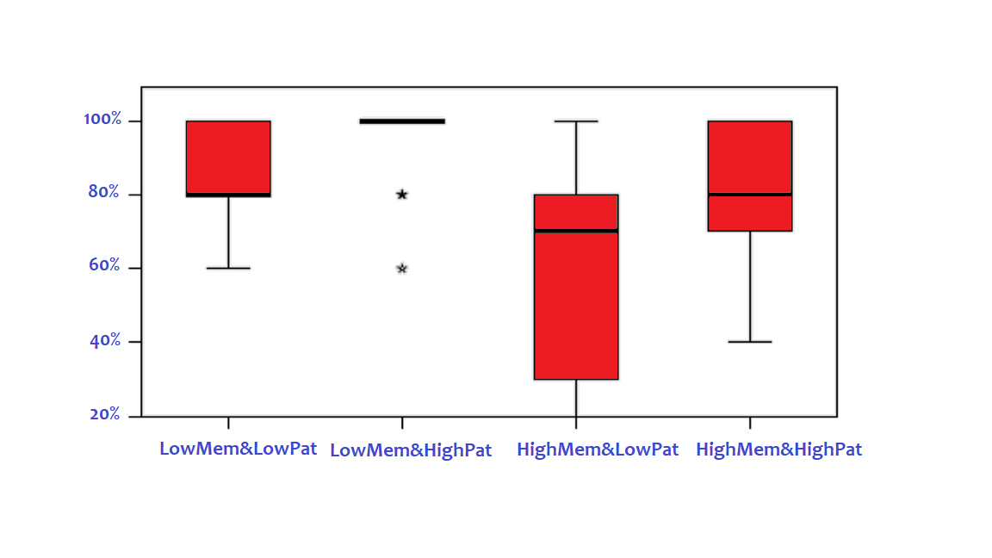
Statistical Learning and Cognitive Constraints on Rule Induction An Entropy Model Silvia RĂDULESCU, Efi GIANNOPOULOU, Frank WIJNEN, Sergey AVRUTIN
From little evidence to abstract rules in language acquisition
statistical learning (Aslin & Newport, 2012)
algebra-like system (Marcus et al, 1999)
Experiments 1&2 - Effect of Entropy on Rule Induction
An Entropy Model
Entropy Channel capacity
(input complexity) (encoding power = entropy/time)
Entropy → a function of the number of different items in the input and their probability of occurrence (frequency)
→ a measure of input complexity (bits)
71 adults, ~22y, ~4min, between-subjects
3-syllable XXY: goo_goo_sjie
manipulated ENTROPY (number & frequency)
2.8 bits (4 × 7Xs / 4 × 7Ys)
3.5 bits (4 × 6Xs / 4 × 6Ys)
4 bits (2 × 12Xs / 2 × 12Ys)
4.25 bits (2 × 14Xs / 2 × 14Ys)
4.58 bits (1 × 24Xs / 1 × 24Ys)
4.8 bits (1 × 28Xs / 1 × 28Ys)
H(X) = $−\sum_{i=1}^{n}{p\left(x_{i}\right)logp\left(x_{i}\right)}$
(Shannon, 1948)
Test (“Could this string be possible in the language that you heard?”)
XXY_trained_syllables: goo_goo_sjie √
X₁X₂Y_new_syllables: reu_loo_gee *
XXY_new_syllables: too_too_suu √
X₁X₂Y _trained_syllables: teu_duu_saa *
Rule Induction → interaction of input complexity (entropy) and channel capacity
5x4=20
items
Yes
No
Entropy > channel capacity → category-based generalizations
Entropy < channel capacity →
item-bound generalizations
Experiment 3 - Effect of Channel Capacity on Rule Induction
51 adults (age 19-44)
Medium Entropy: 2*14 X/2*14 Y (4.2 bits)
3 independent tasks: Forward Digit Span (FDS), Incidental Memorization Task (IMT), Raven’s Standard Progressive Matrices (RSPM)
Dad walked slowly
rule induction
Dad walked slowly
Mom talked nicely
Raven’s Standard Progressive Matrices
Mom talked nicely
Bob
played quietly
Bob
played quietly
Incidental Memorization Task
Training:
30 non-sense bi-syllabic words: go_pem
What does this word sound like?
Surprise memory test:
Have you heard this word before?
13 targets + 13 foils
Flower
Animal
Tool
NOUN+VB+ADV
rule induction
Dad walk-ed slow-ly
Mom talk-ed nice-ly
Bob play-ed quiet-ly
Yes
No
Results Ordinal Regression. Covariates: scores on the tests (FDS, IMT, RSPM). RSPM: significant positive effect on XXY_new and X₁X₂Y _trained;
IMT: significant negative effect on XXY_new and X₁X₂Y _trained.
Rule Induction by Group
XXY new
n = 10
n = 13
n = 8
n = 20
Discussion
Rule induction -> the interaction between input entropy and a limited encoding power of the brain. A low entropy in the input does not boost generalization per se, so it allows for more variation in participants’ individual tendencies to generalize. Thus incidental memory and pattern recognition are predicted to better explain that variation.
No need for algebraic rules. Cognitive constraints on statistical learning explain variations in rule induction.
Conclusions
If input entropy increases, the tendency to generalize increases gradually.
Lower incidental memory predicts a higher tendency to generalize.
Higher visual pattern recognition predicts a higher tendency to generalize.
References
Aslin, R.N., and Newport, E. (2012). Statistical learning: From acquiring specific items to forming general rules. Current Directions in Psychological Science, 21, 170–176.
Marcus, G. F., Vijayan, S., Rao, S. B., & Vishton, P. M. (1999). Rule learning by seven-month-old infants. Science, 283, 77–80.
Shannon, C. E. (1948). A mathematical theory of communication. Bell System Technical Journal, 27, 379–423.

